Slide 1

Neural Substrates of Attention and Awareness
Dan Birman
Gardner Lab
Lightning Talks – 2015-04-23

Slide 2


Slide 5
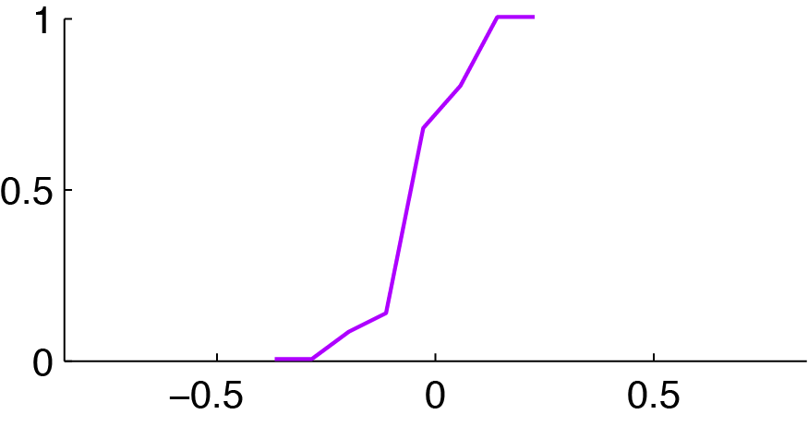
Attention Controls Perception
100% Correct
Attending Motion
0% Correct

Slide 6
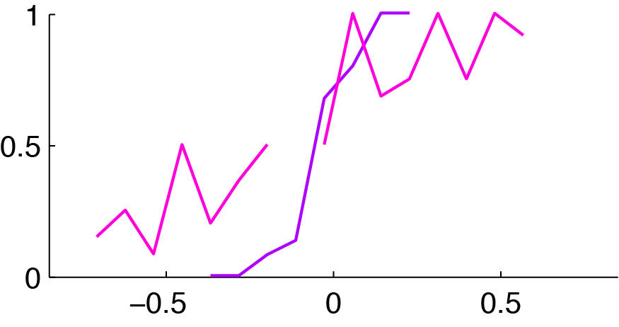
Attention Controls Perception
Attending Motion
Attending Contrast:
Asked about Motion

Slide 7
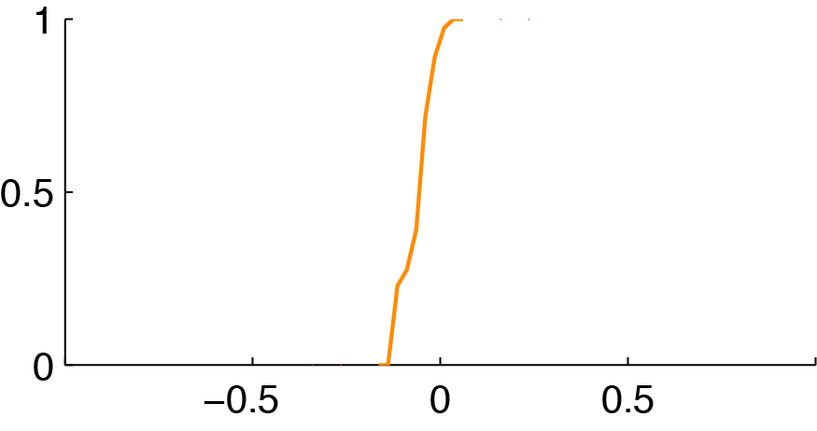
Attention Controls Perception
100% Correct
Attending Contrast
0% Correct

Slide 8
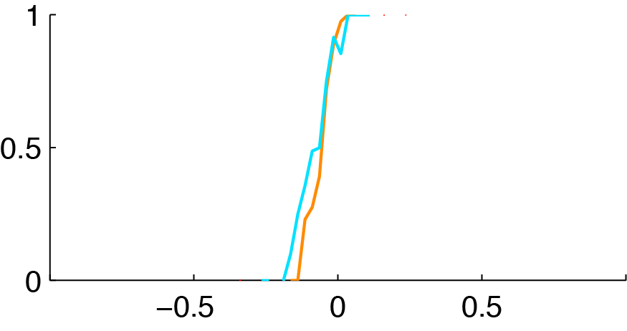
Attention Controls Perception
Attending Contrast
Attending Motion:
Asked About Contrast

Slide 9
Attention Controls Perception
Attending Motion
Attending Contrast:
Asked about Motion
Attending Contrast
Attending Motion:
Asked About Contrast

Slide 10
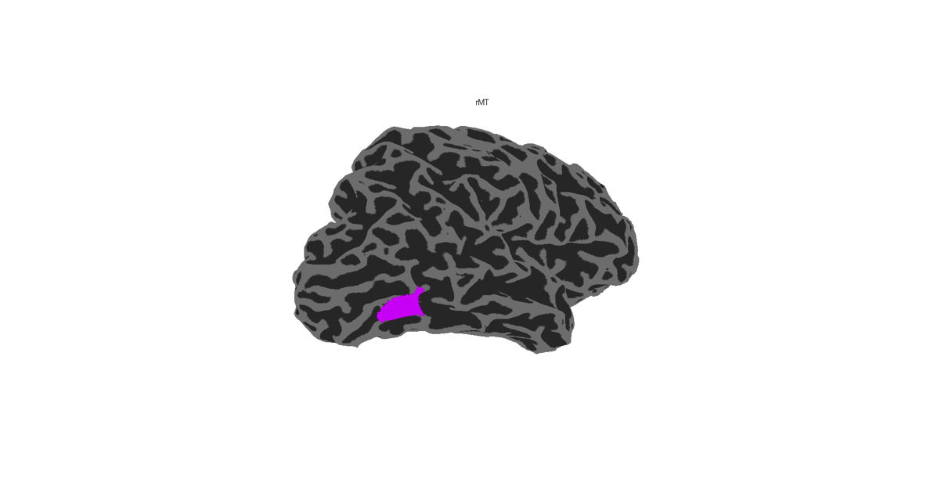
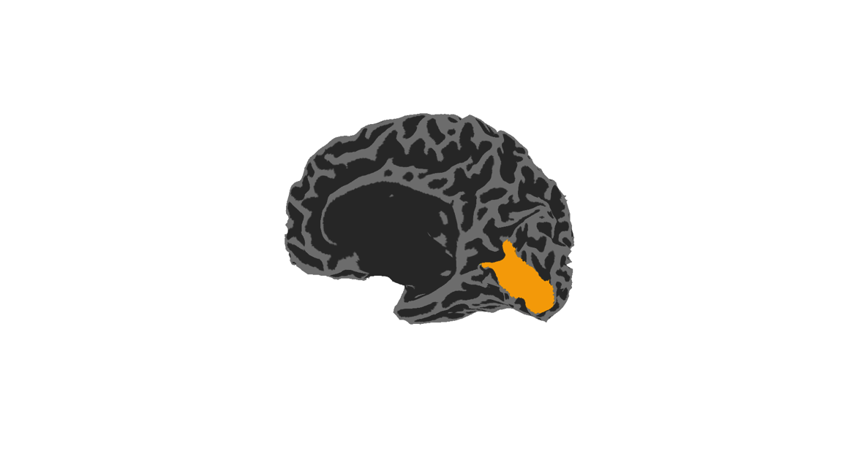
Attention & Visual Hierarchy
hMT
Motion Readout Area
V1
Contrast Readout Area

Slide 11
Attention & Visual Hierarchy
hMT
Response
Stimulus Intensity
V1

Slide 12
Response
Stimulus Intensity

Slide 13
Response
Stimulus Intensity

Slide 14
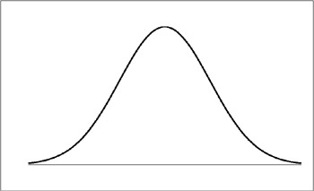
Response
Stimulus Intensity

Slide 15
Attention & Visual Hierarchy
Attending Motion
Attending Contrast:
Asked about Motion
hMT
Replace
w/ data
Attending Contrast
Attending Motion:
Asked About Contrast
V1
Replace
w/ data

Slide 16
Attention & Visual Hierarchy
Attending Motion
Attending Contrast:
Asked about Motion
hMT
Replace
w/ data
Attending Contrast
Attending Motion:
Asked About Contrast
V1
Replace
w/ data

Slide 17
Response Models
Attention
To Motion
Attention
To Contrast

Slide 18
Response Models
Attention
To Motion
Attention
To Contrast

Slide 19
Response Models
Attention
To Motion
Attention
To Contrast

Slide 20
Response Models
Corruption
Attention
To Motion
Attention
To Contrast

Slide 21
Response Models
Corruption
Suppression
Attention
To Motion
-
Attention
To Contrast
+

Slide 22
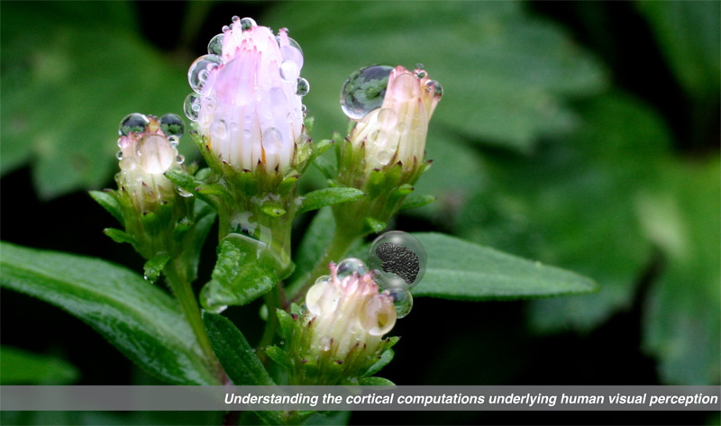

Gardner Lab @ Stanford University
Justin Gardner

